Slide 1

Shree Ramswaroop Memorial University
JavaScript Lab Assignment 6
Submitted to : Kshitiz Srivastav
Submitted By : Mukesh Prajapati
Branch : B . tech (cs industry integrated)
Roll-No : 202410101230007

Slide 2
Weather App

Slide 3
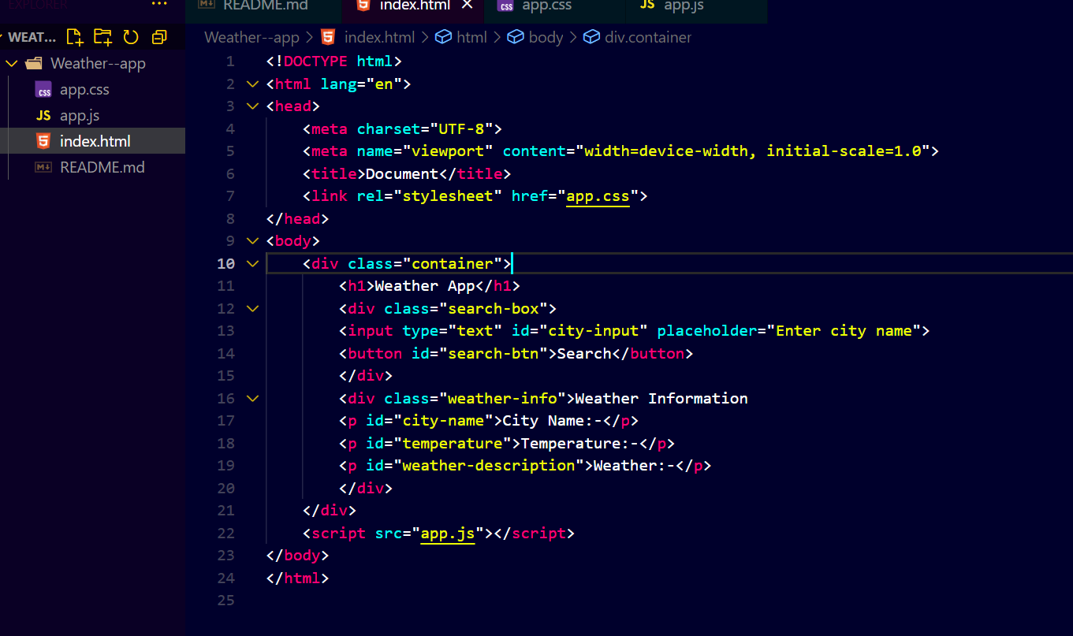
Full HTML Codes:--

Slide 4
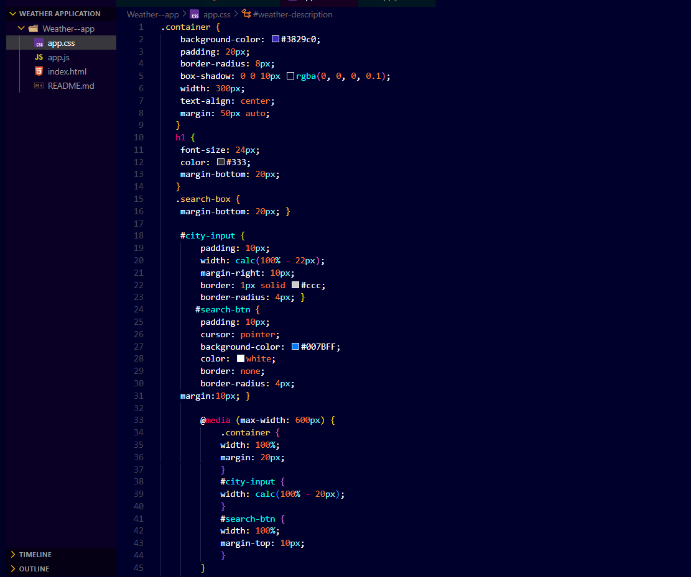
CSS Codes:--

Slide 5
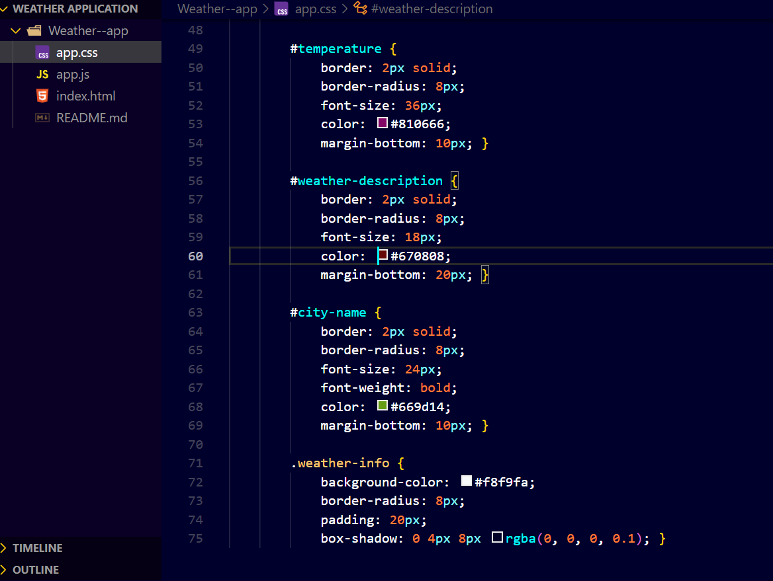
CSS Codes Styling the Current Weather Display Section

Slide 6
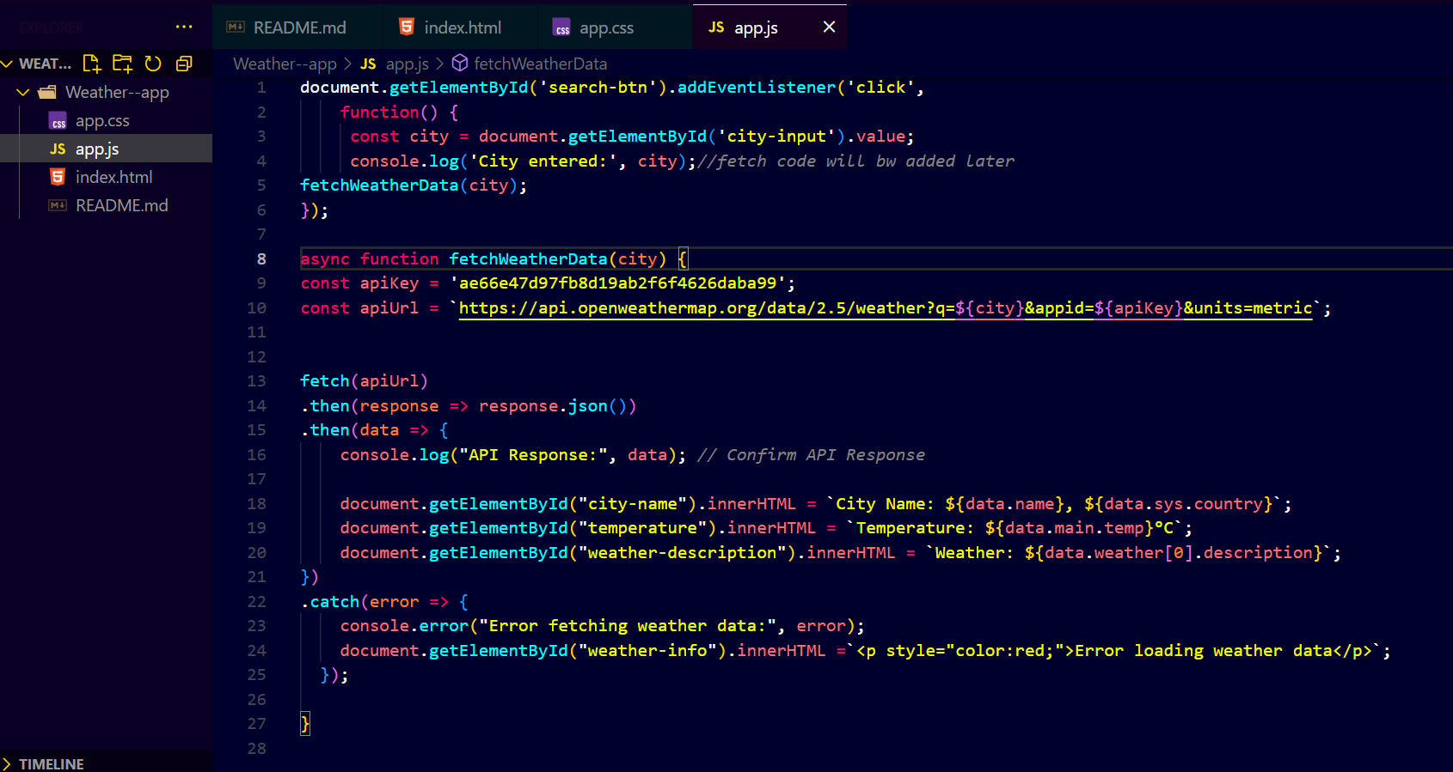
Full codes of javaScript:

Slide 7
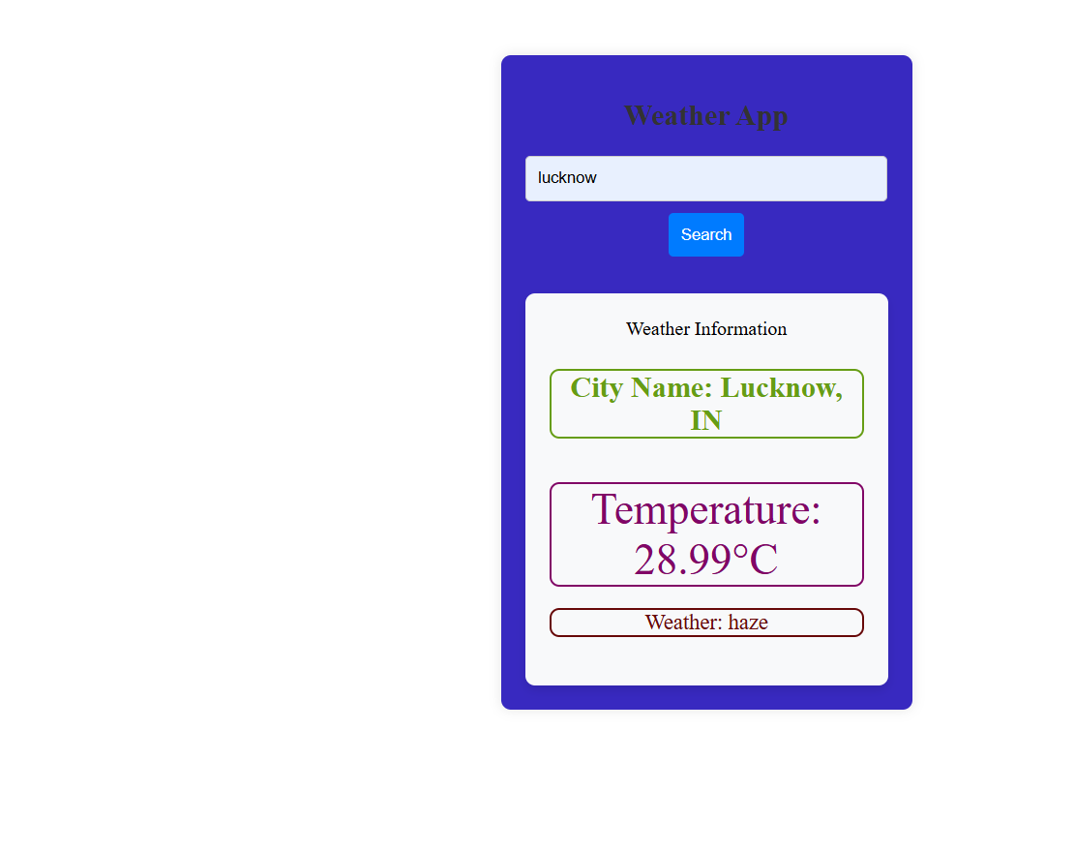
Results of Output

Slide 8
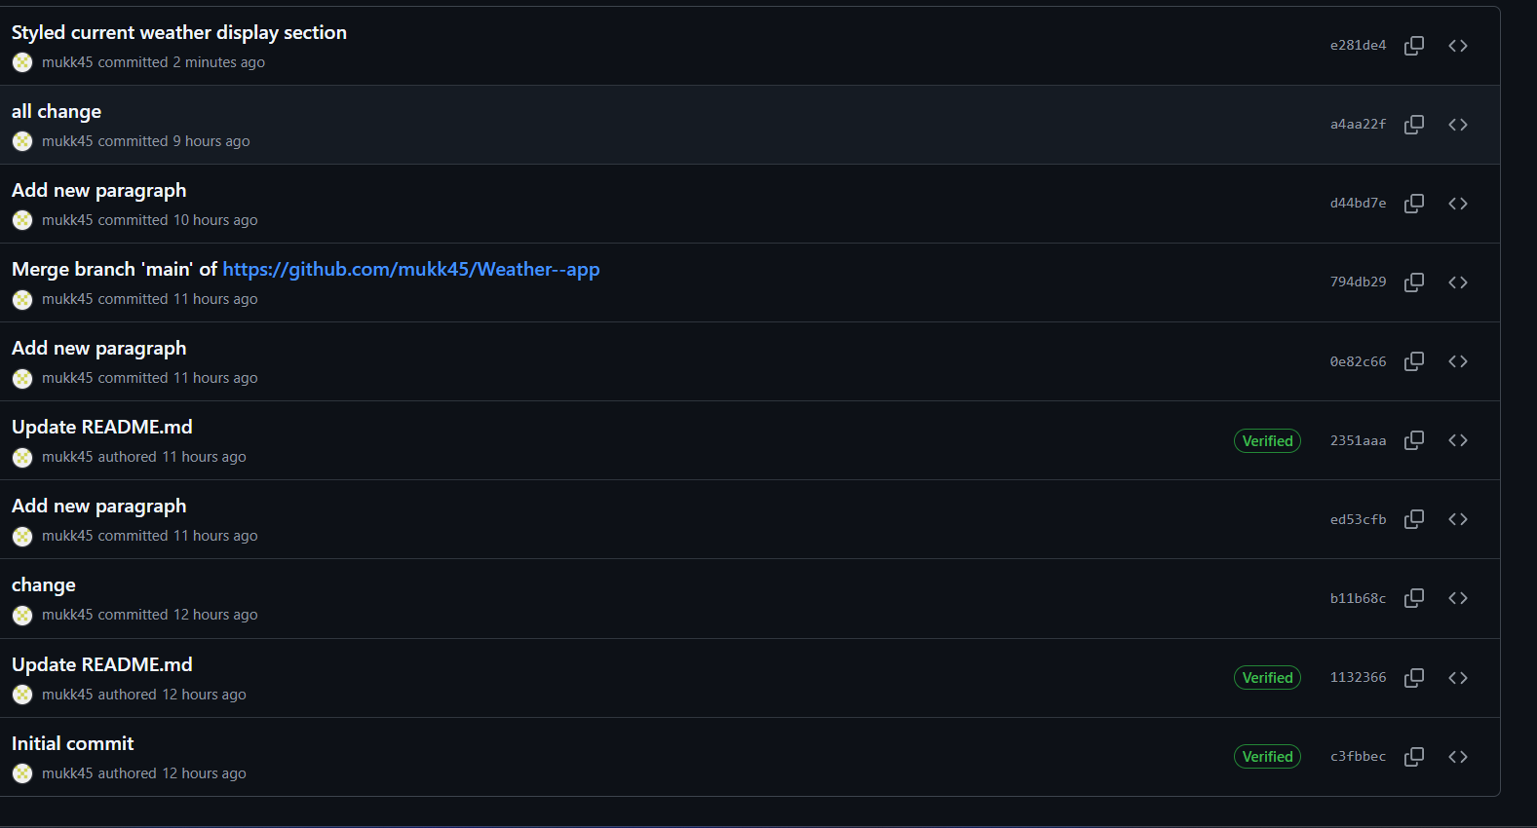
Here is the Commit changes till 6th Experiment:-

